Slide 1
Mantid Progress Report
Nick Draper
09/11/2007

Slide 2
What will Mantid do?
Mantid
  Manipulation and Analysis Toolkit for ISIS Data
Aims
  To provide a framework for Data Analysis that is not instrument or technique/dependent.
  To support multiple target platforms (Windows, Linux).
  The framework must be easily extensible by Instruments Scientists/Users.
  The framework must be freely redistributable to visiting scientists.
  The framework should provide low-level functionalities for Scripting, Visualization, Data transformation, Implementing Algorithms, Virtual Instrument Geometry.

Slide 3
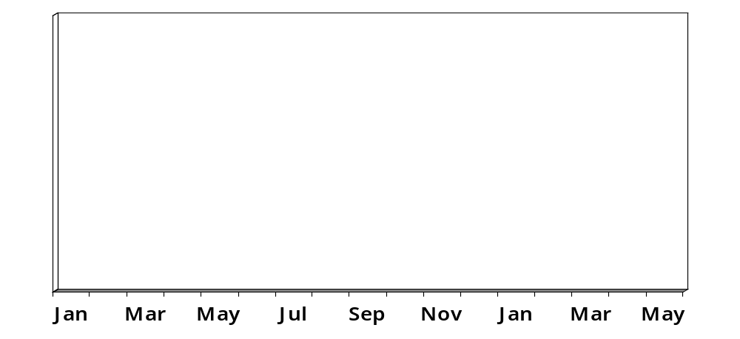
Timeline
Requirements
Design
Pilot Investigations
Scientific Steering Committee
Monthly Iterations
You are here
Initial Release
2007
2008

Slide 4
Software led by Scientists
This is project is intended to support the needs of all of the beamlines.
We need input from each group of instruments
  To ensure what we build fits what you need.
  To ensure good communication between the Mantid project and the scientists.
  To allow each group to have equal input into the project.
To do this we will set up a scientific steering committee.

Slide 5
Scientific Steering Committee
Who?
  The Mantid project manager and one representative from each group of instruments.
What will they do?
  Raise new enhancement requests and report issues.
  Prioritise the list of tasks to be done over the next iterations.
  Review the progress of each iteration.

Slide 6
Scientific Steering Committee
How often?
  Once every 4 weeks just before an iteration starts.
When will this start?
  We plan to start at the end of January.
Where do I sign up?
  Volunteers (with the support of their group) should contact me (Nick Draper).

Slide 7
Further Information
Project Web Page
  www.mantidproject.org
Project Introduction Document
  http://svn.mantidproject.org/mantid/trunk/Documents/Requirements/Project%20Introduction%20Document.doc
User Requirements Document
  http://svn.mantidproject.org/mantid/trunk/Documents/Requirements/URD.doc
Architectural Design Document
  http://svn.mantidproject.org/mantid/trunk/Documents/Design/Architecture%20Design%20Document.doc

Slide 8
Meet the team
Project Manager
  Nick Draper, Tessella
Developers
  Russell Taylor, Tessella
  Laurent Chapon
  Matt Clarke
  Dickon Champion
  Freddie Akeroyd
  Anders Markvarsden
  Stuart Ansell
Sponsors
  Paolo Radaelli
  Toby Perring

Slide 9
Architectural Design - Overview
Instrument log files
Command line & Scripting interface
Mantid Framework
RAW data files
API
Standard Algorithms
User Defined Algorithms
Visualization tool
NEXUS data files
Future Data analysis GUI

Slide 10

Timeline
Milestones
  Architecture design completed October 2007
  Prototype framework released: March 2008
  Functional framework + 2-3 complete applications released March 2009

